Slide 1




Computer Networks
Living in a Network-Centric World
Lecturer: Sura F. Ismail
Lecture One.
Second Class.
Time: 9: 30- 11:30
Department: Informatics Systems Management (ISM)

Slide 2
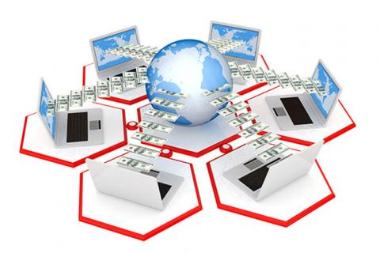
Outline
Outline
Overview
Communicating in a Network-Centric World
Communication: An Essential Part of Our Lives
The Network as a Platform
The Architecture of the Internet
Trends in Networking
6. Trends in Networking

Slide 3
1. Overview
Outline
We now stand at a critical turning point in the use of technology to extend and empower the human network.
The globalization of the Internet has succeeded faster than anyone could have imagined
In the next stage of our development, innovators will use the Internet as a starting point for their efforts—creating new products and services specifically designed to take advantage of the network capabilities.
This lecture introduces the platform of data networks upon which social and business relationships increasingly depend.

Slide 4
2. Communicating in a Network-Centric World
Outline
Humans are social animals who depend on the interaction with others for daily needs.
The ways in which humans interact are constantly changing. As technical developments throughout history have come about, the methods of human communication have developed as well.
At one time, sounds and gestures were all humans used to communicate, but now the Internet allows people to instantaneously share all types of communication—documents, pictures, sound, and video—with thousands of people near and far away using computers.
Networks supporting the way we live, learn, work, and play.

Slide 5
3. Communication: An Essential Part of Our Lives
Outline
Communication in our daily lives takes many forms and occurs in many environments. We have different expectations depending on whether we are chatting through the Internet or participating in a job interview. Each situation has its corresponding expected behaviors and styles.
These expectations are the rules of communication, and some of the elements are universal.
People have many ways of communicating with each other.

Slide 6
3. Communication: An Essential Part of Our Lives
Outline
The rules of communication are also known as protocols. Some of the protocols required for communication to occur include the presence of
An identified sender and receiver.
An agreed-upon method of communicating (face-to-face, telephone, letter, photograph, and so on).
Common language and grammar.
An agreed-upon speed and timing of delivery (for example, “Please slow down so that I can understand you.”).
Confirmation or acknowledgment requirements (for example, “Is that clear?” “Yes, thank you.”)

Slide 7
3. Communication: An Essential Part of Our Lives
Outline
Computers and computer networks have no such ingrained communication knowledge, but similar protocols are still required for network devices to communicate. Successful communication between computer networks devices, just as is true with communication between people, occurs when the meaning of the message understood by the recipient matches the meaning intended by the sender.
There are many potential barriers to successful communication between computers on a network. The process of sending a message on a computer network can be complex and have many steps and conditions, and any step poorly performed or condition not properly met can potentially ruin the message. The steps and conditions, or factors, can be separated into internal and external groups.

Slide 8
3. Communication: An Essential Part of Our Lives
Outline
Examples of external factors include the following:
The quality of the pathway between the sender and the recipient.
The number of times the message has to change form.
The number of times the message has to be redirected or readdressed.
The number of other messages being transmitted simultaneously on the communication network.
The amount of time allotted for successful communication.
Internal factors include the following:
The size of the message.
The complexity of the message.
The importance of the message.

Slide 9
4. The Network as a Platform
Outline
The ability to reliably communicate to anyone, anywhere, is becoming increasingly important to our personal and business lives.
To support the immediate delivery of the millions of various messages being exchanged among people all over the world, we rely on a web of interconnected networks.
The following sections describe communication over networks, different elements that make up a network, and convergence.

Slide 10
4. The Network as a Platform
Outline
The webs of data or information networks vary in size and capabilities, but all networks have four basic elements in common:
Rules or agreements: Rules or agreements (protocols) govern how the messages are sent, directed, received, and interpreted.
Messages: The messages or units of information travel from one device to another.
Medium: A medium is a means of interconnecting these devices, that is, a medium can transport the messages from one device to another.
Devices: Devices on the network exchange messages with each other.

Slide 11
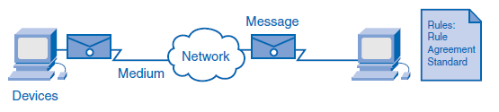
4. The Network as a Platform
Outline
Early networks had varying standards and, as a result, could not communicate easily with each other. Now global standardization of these elements enables easy communication between networks regardless of the equipment manufacturer.

Slide 12
4. The Network as a Platform
Outline
Message
Message is a generic term that encompasses web pages, e-mail, instant messages, telephone calls, and other forms of communication enabled by the Internet.
Medium
The medium that physically carries the message can change several times between the sender and the receiver. Network connections can be wired or wireless.

Slide 13
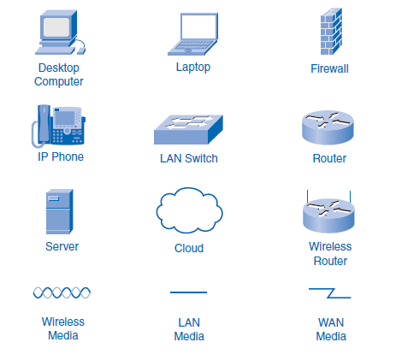
4. The Network as a Platform
Outline
Devices
Several devices, such as switches and routers, work to see that the message is properly directed from the source, or originating device, to the destination device.

Slide 14
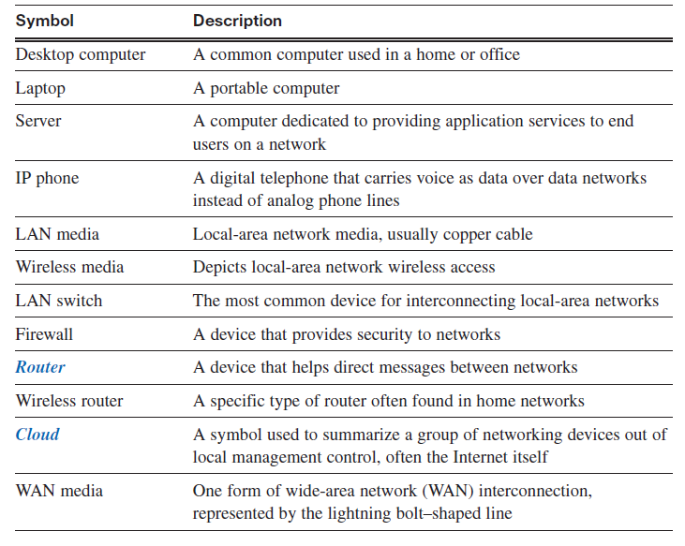
4. The Network as a Platform
Outline

Slide 15
4. The Network as a Platform
Outline
Rules
All communication processes happen, as far as humans can tell, in an instant, and tens of thousands of processes can happen in a single second. To work properly, the network processes must be tightly controlled. Rules govern every step of the process, from the way cables are designed to the way the digital signals are sent. These rules are called protocols, and the communications industry has standardized most of them to allow people in different places with different equipment to communicate. The most common protocols are IP (Internet Protocol) and TCP (Transmission Control Protocol). These protocols work together and are usually known as the TCP/IP protocol stack.

Slide 16
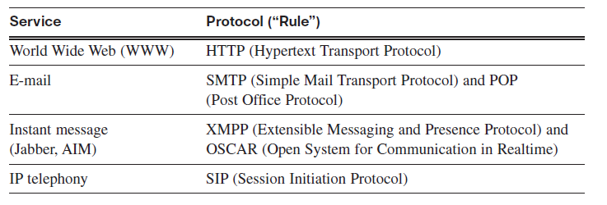
4. The Network as a Platform
Outline
People often only picture networks in the abstract sense: We create and send a text message, and it almost immediately shows up on the destination device. Although we know that between our sending device and the receiving device there is a network over which our message travels, we rarely think about all the parts and pieces that make up that infrastructure.

Slide 17
4. The Network as a Platform
Outline
The following list ties together how the elements of networks—devices, media, and services—are connected by rules to deliver a message:
1. An end user types an instant message to a friend using an application on a PC.
2. The instant message gets converted into a format that can be transmitted on the network.
All types of message format—text, video, voice, or data—must be converted to bits before being sent to their destinations. After the instant message is converted to bits, it is ready to be sent onto the network for delivery.
3. The network interface card (NIC) inside the PC generates electrical signals to represent the bits and places the bits on the medium so that they can travel to the first network device.
4. The bits are passed from device to device in the local network.

Slide 18
4. The Network as a Platform
Outline
5. If the bits need to leave the local network, they leave through a router connecting to a different network. There can be dozens, even hundreds, of devices handling the bits as they are routed to their destination.
6. As the bits get close to their destination, they once again get passed through local devices.
7. Finally, the NIC on the destination device accepts the bits and converts them back into a readable text message.

Slide 19
4. The Network as a Platform
Outline
Converged Networks
Communication technologies evolved at different times and in different places in the twentieth century. Many developments in radio broadcast technology were driven by military necessity, yet developments in broadcast television grew to answer a market demand. The telephone evolved as a wired technology and then as a wireless technology.
The technology and protocols of each of these communication methods developed largely independent of each other, and most users of TV, telephone, and computer services pay different providers for each service. But recent developments in each area have driven broadcast and telephony to the digital technology already used by computers. This coming together of technologies onto a digital platform is called convergence.

Slide 20
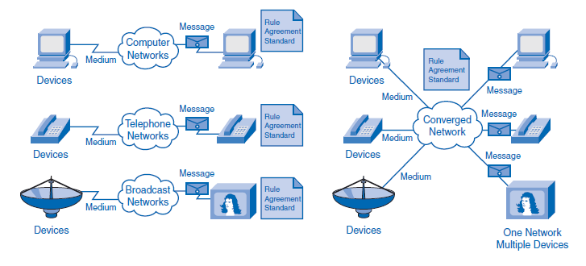
4. The Network as a Platform
Outline
Converged Networks
Convergence occurs when telephones, broadcasts, and computer communications all use the same rules, devices, and media to transport their messages. On a converged network, or platform, different devices, such as televisions or cell phones, will use a common network infrastructure to communicate.

Slide 21
5. The Architecture of the Internet
Outline
The term network architecture refers to the conceptual plans on which a physical network is built. Just as a building’s architect must consider the function of the building and the expected needs of a building’s users, so too must network architects design the Internet to accommodate the needs of the web and its users. The Internet has far exceeded the original expectations of size and use, which is a testament to how strong the foundations of the Internet were planned and implemented.
The Internet’s design meets four fundamental expectations: fault tolerance, scalability, quality of service (QoS), and security.

Slide 22
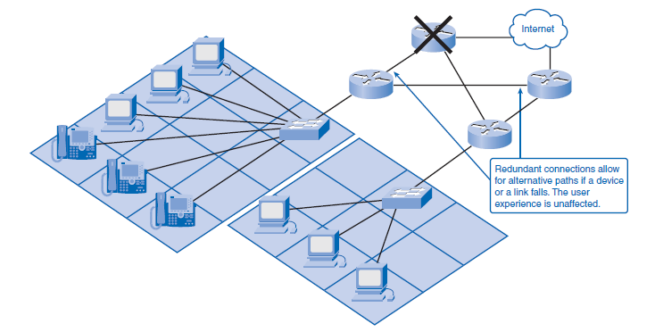
5. The Architecture of the Internet
Outline
Fault tolerance, simply stated, means that the Internet will continue to function normally even when some of the components of the network fail. Redundancy, or the duplication of equipment and media, is a key factor in fault tolerance. If a server fails, a redundant server performing the same functions should be able to pick up the work until repairs are made. If a data link fails on a fault-tolerant network, messages will be routed to the destination on a duplicate route.

Slide 23
5. The Architecture of the Internet
Outline
Scalability describes the network’s ability to grow and react to future changes. A scalable network can accept new users and equipment without having to start over on the design.
QoS indicates the performance level of services offered through the network. Services such as live video or voice can require more resources than services such as e-mail.
Network security is essential if the public is to have confidence when using the Internet. People using the Internet to do business demand security for their financial transactions, and government and businesses that require personal information (for example, a hospital or doctor’s office) must provide the protection of their clients’ privacy.

Slide 24
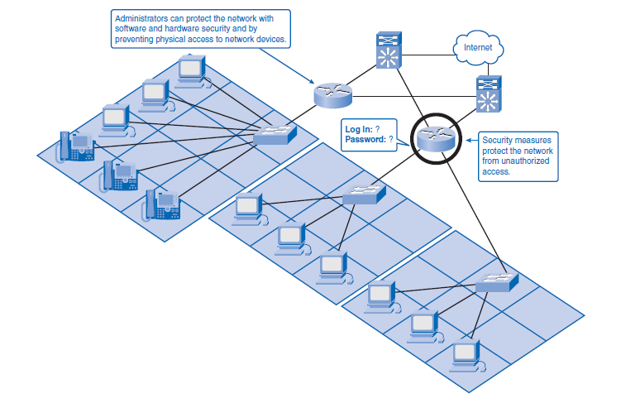
5. The Architecture of the Internet
Outline
Encryption and firewalls are not necessarily enough to protect a network, however. The security and privacy expectations that result from the use of internetworks to exchange confidential and business-critical information exceed what the current architecture can deliver.

Slide 25
6. Trends in Networking
Outline
Making precise predictions about the distant future of technology is a difficult task. Looking at current trends can show near-term developments that are on the horizon and the career opportunities that can be available to you.
Where Is It All Going?
The convergence of the many different communication media onto a single network platform is fueling exponential growth in network capabilities. Three major trends are contributing to the future shape of complex information networks:
Increasing number of mobile users
Rapid increasing in a network-capable devices
Expanding range of services

Slide 26


THANK YOU

